Slide 1
ENGR 12
Dr. Mandala
Notes:
Down

Slide 2
Work in your teams to answer
How many output/input variables are defined in functions:
function counter(start)
0/1
function avg=basic_stats(value)
1/1
function [avg, total]=sales(month,autosales)
2/2
function [scores,avg]=student_grades()
2/0
Function hellworld()
0/0

Slide 3
Work in your teams to answer
What is the value and datatype of nargout, when:
function varargout=counter(start)
>> [start, end]=counter(89);
2, numeric array with one value
>> [start, end, mid]=counter(2);
3, numeric array with one value
>> counter(2);
0

Slide 4
Work in your teams to answer
What is the value and datatype of nargin and varargin, when:
function avg=grades(varargin)
>> classavg=grades(scores,57,100);
Nargin = 3
Varargin = {scores, 57, 100}
>> classavg=grades()
Nargin = 0
Varargin = []

Slide 5
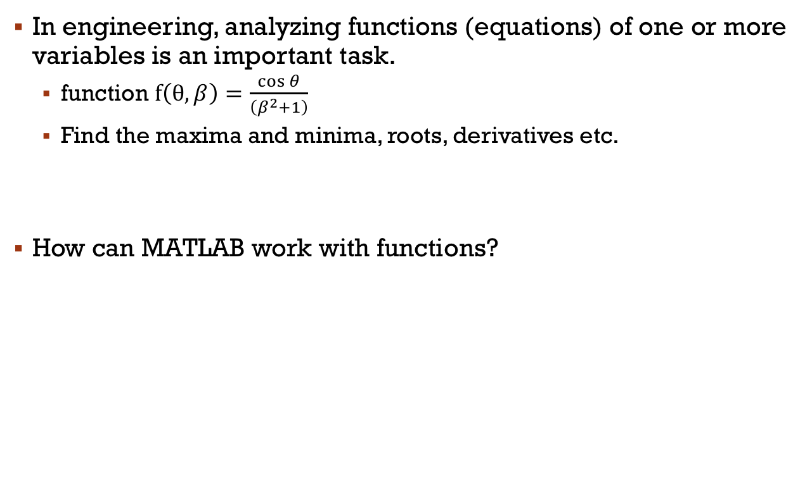
Functional Analyses
In engineering, analyzing functions (equations) of one or more variables is an important task.
function $f\left(θ, β\right)=\frac{\cos{θ}}{\left(β^{2}+1\right)}$
Find the maxima and minima, roots, derivatives etc.
How can MATLAB work with functions?

Slide 6

STEP 1: Define the function
How do you let MATLAB know what is the function equation?
Example:
Method 1: Entering the function as a string (will not be supported in future)
f=‘sin(x)./(x.^2+1)’
Method 2: Creating a MATLAB function (m-file)
function y=eq1(x)
…
Method 3: Creating an anonymous function (recommended)
f=@(x)sin(x)./(x.^2+1);

Slide 7
STEP 2: analyze the function
For example, to plot the defined equation you can use fplot
>> f=@equation1;
>> fplot(f,[-10 10]);
Several MATLAB built-in functions can help analyze engineering equations
Function | description
fplot | Plots 2D mathematical function
feval | Evaluates a mathematical function
fzero | Finds roots of a mathematical function
fminbnd | Finds minima of mathematical functions
quad,quadl | Numerical integration
trapz | Trapezoidal numerical integration
diff | Numerical differentiation

Slide 8
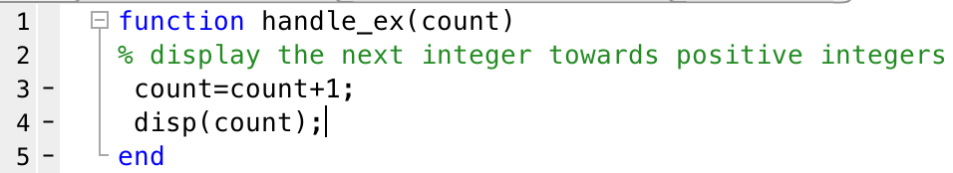
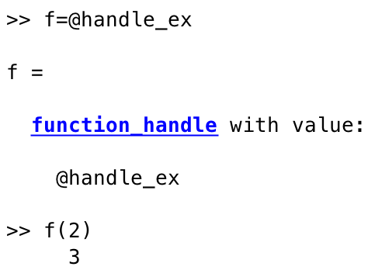
Creating Function Handle
Is a MATLAB value (data-type) that provides a means to call or invoke a function indirectly. You can even use it as an argument for other functions.
use @ next to function name to define function handle
invoke function using handle

Slide 9
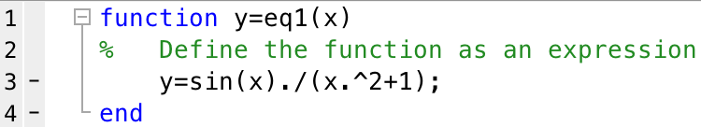
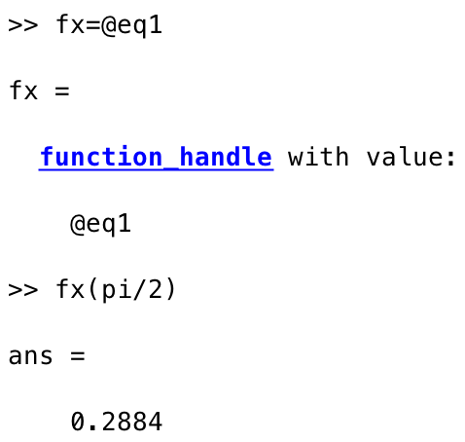

Creating function handle sample
Create function handle
Invoke function
Analyze/plot

Slide 10
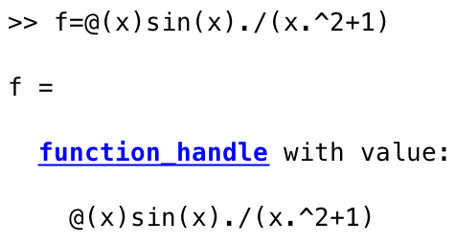
Anonymous function
Quick way to define a equation/function
Does not require a new m-file with function in it.
Create function and return handle in one step
function_handle=@(argument_list)expression
argument_list: variables in function, x, y, z etc.
expression: single MATLAB expression containing variables
Now, you can use f in all analyses methods
fplot(f,[-10 10])

Slide 11
Plotting math functions
fplot plots a mathematical function
Syntax: fplot(fun)
Plots fun (a function handle or equation as a string) between limits of the current axes (default of [-5 5]).
Syntax: fplot(fun,lims)
Plots fun (a function handle or equation as a string) between limits defined by array lims (example lims=[-10 10]).
Note to define x and y limits use [xmin xmax ymin ymax]

Slide 12
Download handout
Download Handout

